Slide 1
GLORIOSA SUPERBA

Slide 2
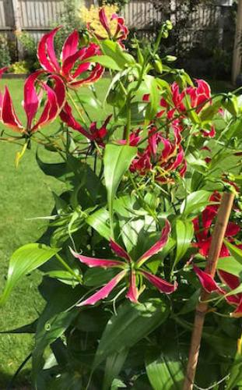
CLASSIFICATION
Family : Liliaceae
Indian and English name : Climbing lily,Glory lily,Malabar glory lily
Hindi name : Kalihari,Kathari,Kulhari
Distribution : Found in Rajasthan, Maharashtra, Karnataka, Tamil Nadu.

Slide 3
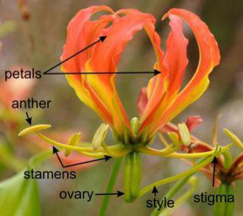
MORPHOLOGY
A climbing herb possessing white, cylindric,forked tubers.
Flowers large, solitary, axillary; its pedicel reflexed near the tip.
Perianth-segments 6, narrow, petaloid, spreading or reflexed with margins usually undulate
Fruit a oblong capsule.
Flowers are 6 to 10 cm long, and 1 to 2.5 cm wide. The pedicel be up to 20 cm long. Flower has 6 stamens, the length of stamens is between 3 to 4 cm, and each bears a large anther at the tip that drops large amounts of yellow pollen. The fruit is a large, oblong capsule, 6 to 12 cm long, and containing about 20 globose red colored seeds in each value.
Flowering and fruiting: July-October.
Habitat: common in forests and along capsule.

Slide 4
MEDICINAL USES (LEAVES)
Leaf juice forms one of the important ingredients in arrow poison; also useful against head lice.
Sap from the leaf tip used for checking pimples and skin eruptions.
It has been used in the treatment of gout, infertility, open wounds, snakebite, ulcers, arthritis, cholera, colic, kidney problems, typhus, itching, leprosy, bruises, sprains, hemorrhoids, cancer, impotence, nocturnal emission, smallpox, sexually transmitted diseases, and many types of internal parasites.

Slide 5
USES OF ROOTS AND /TUBERS
Poultice of root paste good against rheumatoid arthritis and joint pains.
Root paste applied over the navel region for quick delivery.
Tuber paste applied for skin diseases.
Purified tuber paste with butter given with sugar candy for curing blood disorders.
Tuber paste mixed with leaf juice of Datura metel applied for fistula.
Tuber has commonly been employed as a suicidal and homicidal agent by rural populace.

Slide 6
ACTIVE CONSTITUTENTS
Superba has been reported to have many chemical constituents including colchicine, β- sitosterol, glumicolchicine, b-lumicolchicine, 2-OH-6-MeO-benzoic acid, glorisine, tannins, colchicoside, cornigerine, luteolinn.
MAJOR AYURVEDIC FORMULATIONS :
Nirundi taila,Rumalya cream,langali gutika, Nirgundi taila,Languli rasayana, Mahabhutarasa ghtra, Laghu visagarva taila, Mahavisagarbha taila.

